Slide 1
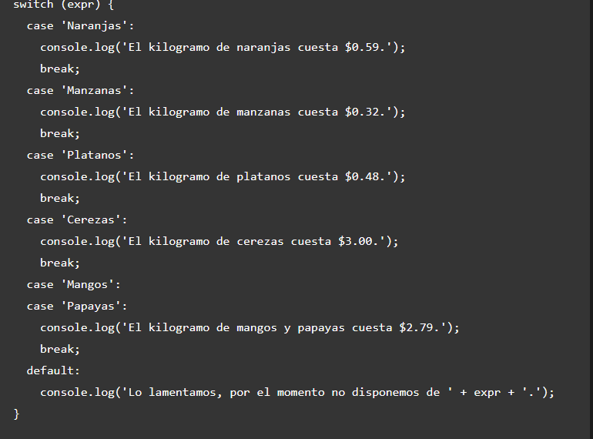

Switch case statement

Slide 2


Operadores ternarios

